Slide 1


Mughesh Kumar N r
SkillsBuild Email ID: mugheshkumar3@gmail.com
College Name: SRM Institute of Science and Technology.
College State: Tamil Nadu
Internship Domain and Start and End Date: Artificial Intelligence/ 12th June 2023 – 24th July 2023

Slide 2

PROBLEM STATEMENT
In today's fast-paced and stressful world, mental health has become a significant concern. Many individuals struggle with managing their mental well-being due to various factors such as increased work pressure, social isolation, and limited access to mental health resources. This has led to a rising demand for innovative solutions that can effectively monitor and improve an individual's mental fitness.

Slide 3

AGENDA
The project "Mental Health Fitness Tracker" aims to analyze and predict the mental fitness levels of individuals across different countries, taking into account various mental disorders. By employing regression techniques, this innovative initiative offers valuable insights into mental health and utilizes available data to make accurate predictions. Furthermore, the project encompasses a user-friendly platform where individuals can effectively monitor and track their own mental health and fitness levels.

Slide 4

PROJECT OVERVIEW
The Mental Health Fitness Tracker empowers individuals to actively monitor and manage their mental well-being.
Through data analysis and anomaly detection, the tracker can identify potential mental health concerns at an early stage. This enables timely intervention, facilitating preventive measures and reducing the risk of more severe mental health issues.
By leveraging EDA and machine learning techniques, you can gain insights into the factors affecting mental fitness and develop models that can provide accurate predictions and valuable recommendations.

Slide 5

WHO ARE THE END USERS of this project?
The end users of the Mental Health Fitness Tracker project can include individuals who are seeking to monitor, improve, and maintain their mental well-being.
Some end users: Individuals with Mental Health Concerns, Mental Health Professionals, Healthcare Providers and Organizations, Researchers and Policy Makers, and soon.

Slide 6

YOUR SOLUTION AND ITS VALUE PROPOSITION
By combining EDA techniques and implementing machine learning algorithms, your solution context allowed you to gain insights into the dataset, explore correlations, select relevant features, and build a predictive model for mental fitness.
Overall, our Mental Health Fitness Tracker aims to be a valuable tool in promoting mental well-being, supporting individuals in their mental health journey, and making a positive impact on their lives.

Slide 7

How did you customize the project and make it your own
In customizing the project, I made several modifications and enhancements to tailor it to my specific needs and objectives. Here are the key customizations I implemented:
Data Preprocessing: I performed data preprocessing steps to handle missing values in the dataset with mean.
Exploratory Data Analysis (EDA): I conducted extensive EDA using techniques such as confusion matrix, pie charts, histograms, and line plots.
Data Transformation: To prepare the data for machine learning algorithms, I employed label encoding to convert categorical variables into numerical representations.
.

Slide 8
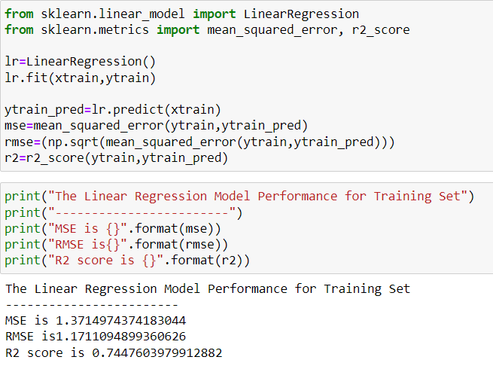
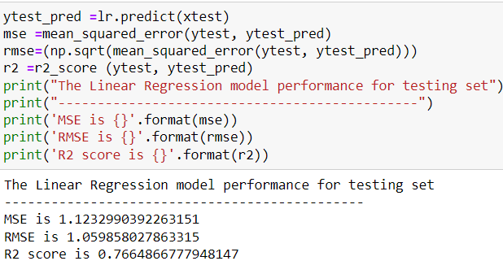
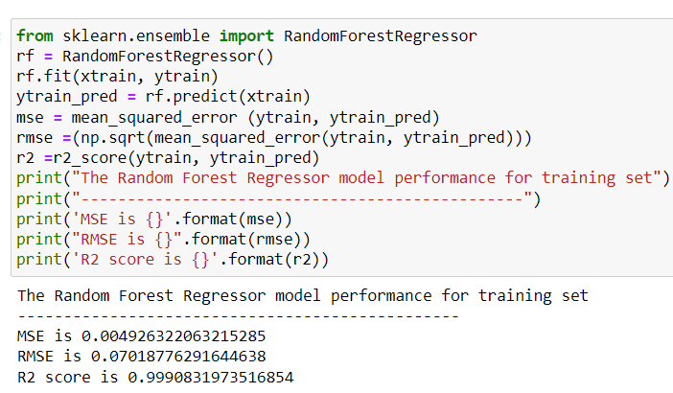
MODELLING
Machine Learning Algorithms: I trained and compared the performance of three machine learning algorithms: logistic regression, and Random forest regression.

Slide 9
Results
The RMSE value of every model created suggests that the random forest model has a high level of precision and closely approximates the actual mental fitness values in the dataset.(Very Low)
My project's results indicate that the random forest regression model delivers the highest accuracy in predicting mental fitness. These findings suggest that model may be the most suitable for project's objectives and can provide valuable insights into mental well-being based on the available data.

Slide 10
links
https://github.com/mughesh03/Mental_Fitness_Tracker_IBM.git

